Slide 1
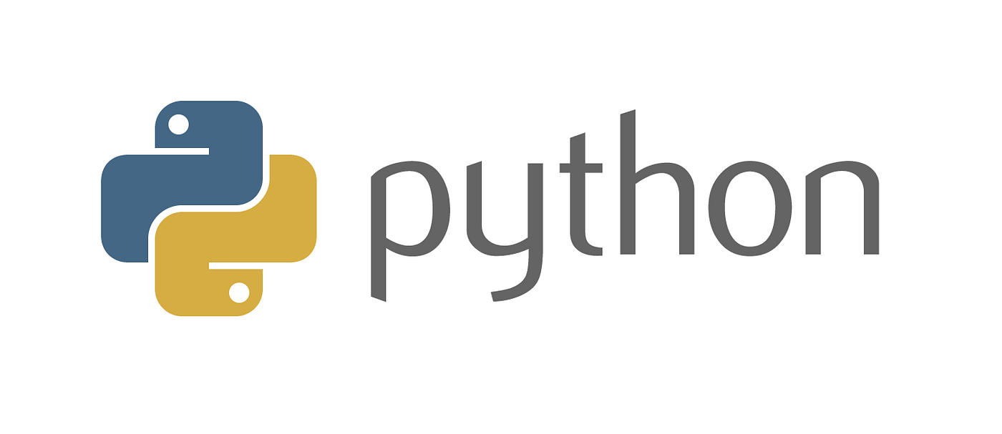
Numerical Analysis with Python

Slide 2
CONTACT INFORMATION
Instructor: Bora Döken
E-mail: dokenb@itu.edu.tr

Slide 3
COURSE INFORMATION
Text Books:
Python_Programming_and_Numerical_Methods_A_Guide_for_Engineers_and_Scientists
Numerical Methods in Engineering with Python 3
Web Pages:
https://www.python.org/
https://www.spyder-ide.org/
https://www.anaconda.com/

Slide 4
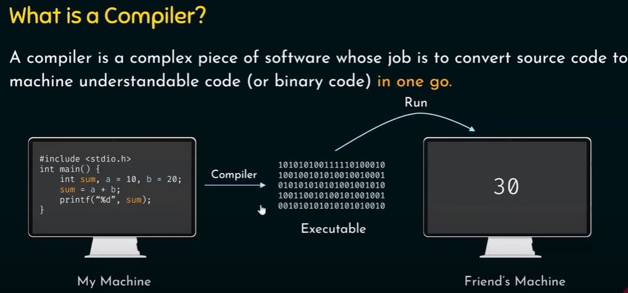
Compilers and Interpreters
Programs written in high-level languages must be translated into machine language to be executed
Compiler: translates high-level language program into separate machine language program
Machine language program can be executed at any time

Slide 5
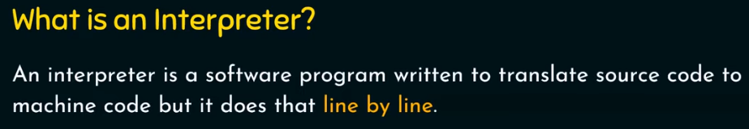
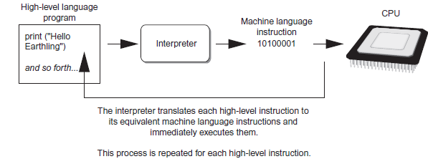
Interpreter: translates and executes instructions in high-level language program
Used by Python language
Interprets one instruction at a time
Source code: statements written by programmer
Syntax error: prevents code from being translated
Typical Python implementations offer both an interpreter and compiler.

Slide 6

Brief History of Python
Invented in the Netherlands, in the early 90s by Guido van Rossum.
Open source from the beginning.
Considered a scripting language, but is much more.
Scalable, object-oriented, and functional from the beginning.

Slide 7
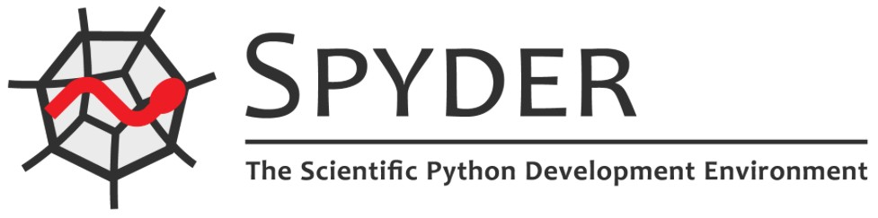


Python Editors
Python IDLE
Spyder (Anaconda distribution)
PyCharm
Visual Studio Code
Visual Studio
Jupyter Notebook
…

Slide 8
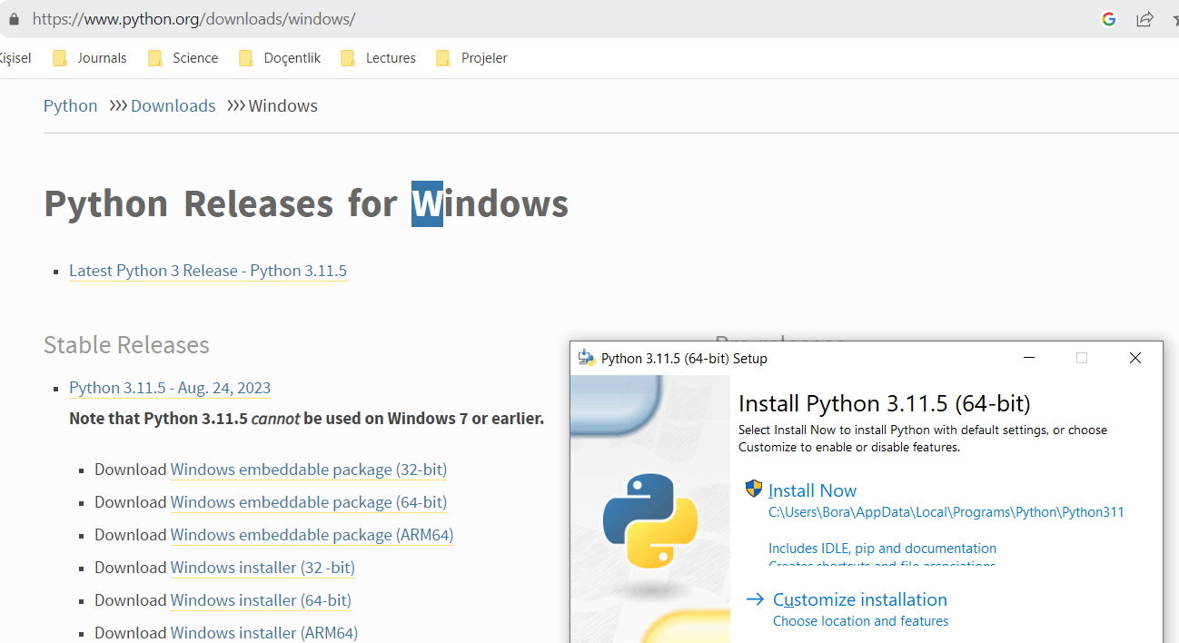
Python IDLE

Slide 9
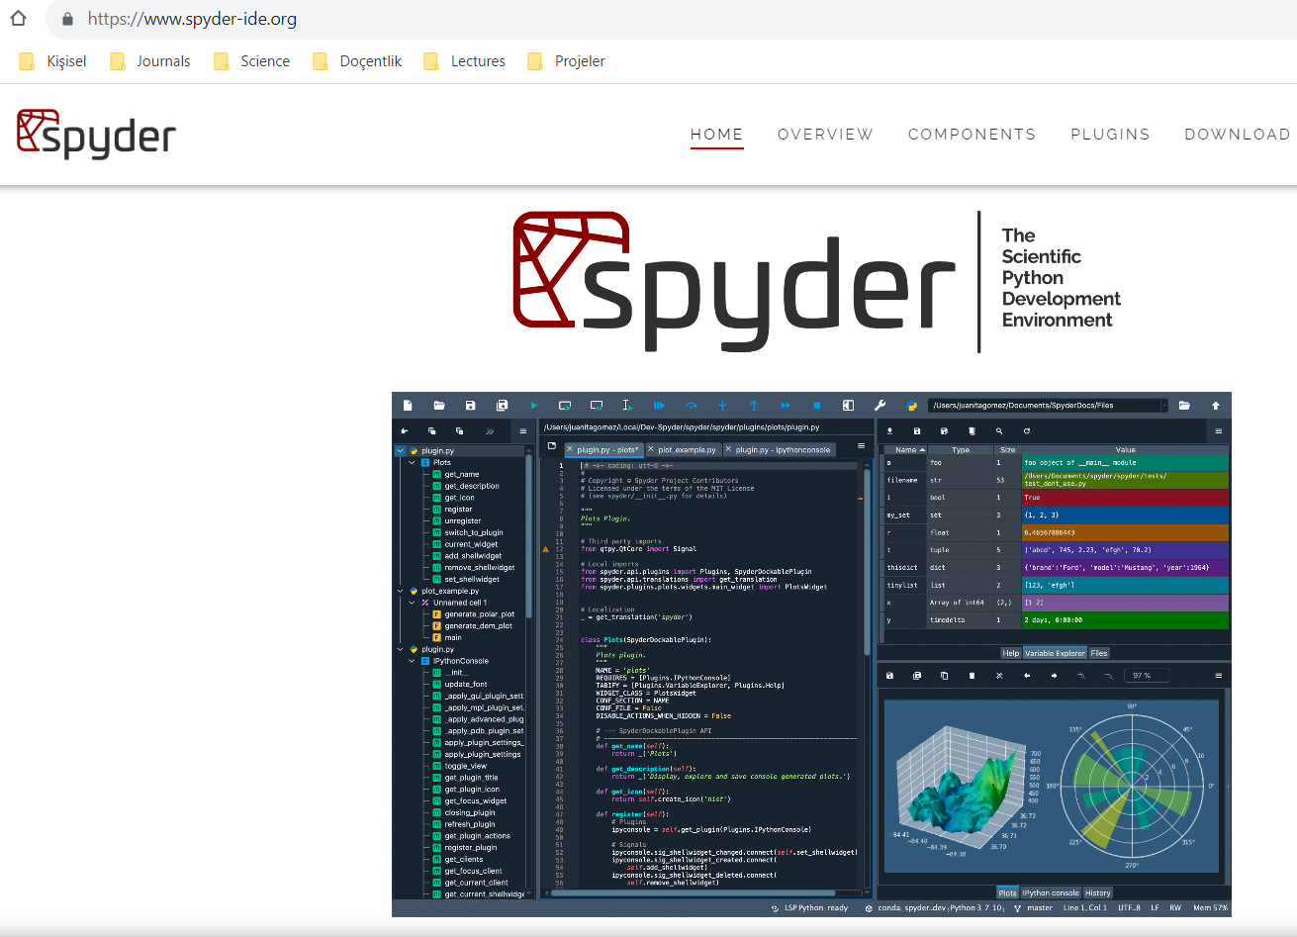
Spyder

Slide 10
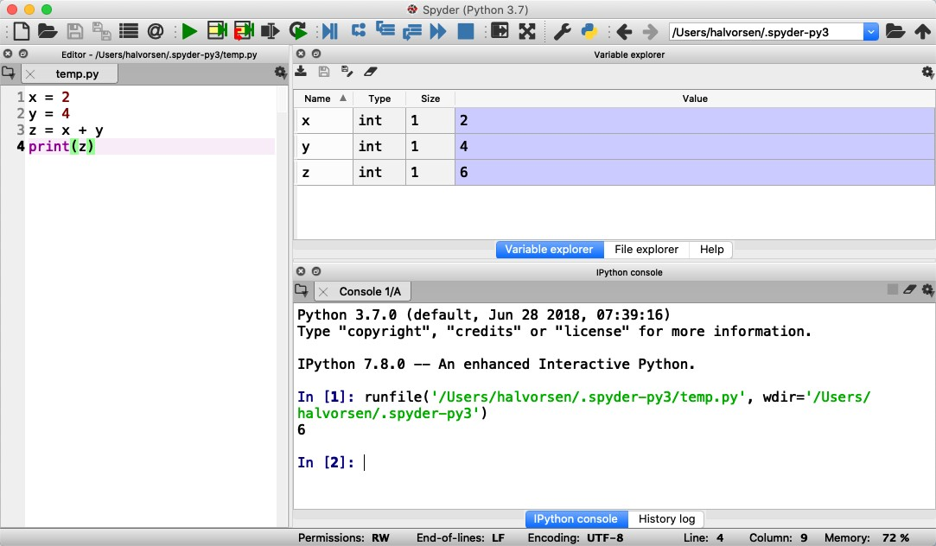
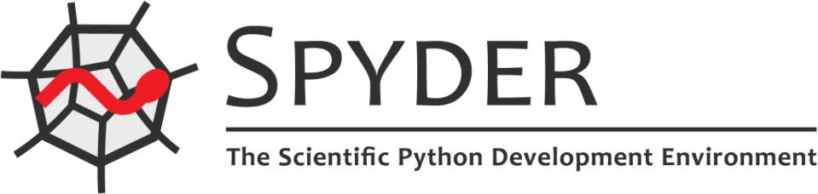
Spyder (Anaconda distribution)
Spyder, the Scientific Python Development Environment, is a free integrated development environment (IDE) that is included with Anaconda. It includes editing, interactive testing, debugging, and introspection features.
Run Program button
Variable Explorer window
Code Editor window
https://www.anaconda.com
Console window

Slide 11



Variables in Python
Creating variables: We can use variables in a calculation like this:
x = 3
x 3
x = 3
y = 3*x
print(y)
We can implement the formula
𝑦(𝑥) = 𝑎𝑥 + 𝑏 like this:
𝑦(𝑥) = 2𝑥 + 4
print(y)
A variable can have a short name (like x and y) or a more descriptive name (sum, amount, etc).
a = 2
b = 4; x=4
y=a*x+b

Slide 12
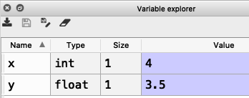
Numbers
The symbol # is used for commenting the code
There are three numeric types in
Python:
int
float
complex
x = 1 #int
y = 2.8 #float
z = 3 + 2j #complex number
If you use the Spyder Editor, you can see the data types that a variable has using the Variable Explorer
Variables of numeric types are automatically created when you assign a value to them, so in normal coding you don't need to bother.

Slide 13



Strings
Strings in Python are surrounded by either single quotation marks, or double quotation marks.
'Hello' is the same as "Hello".
Strings can be output to screen using the print function. For example: print("Hello").
> text = ”Hello“
> print(text)

Slide 14

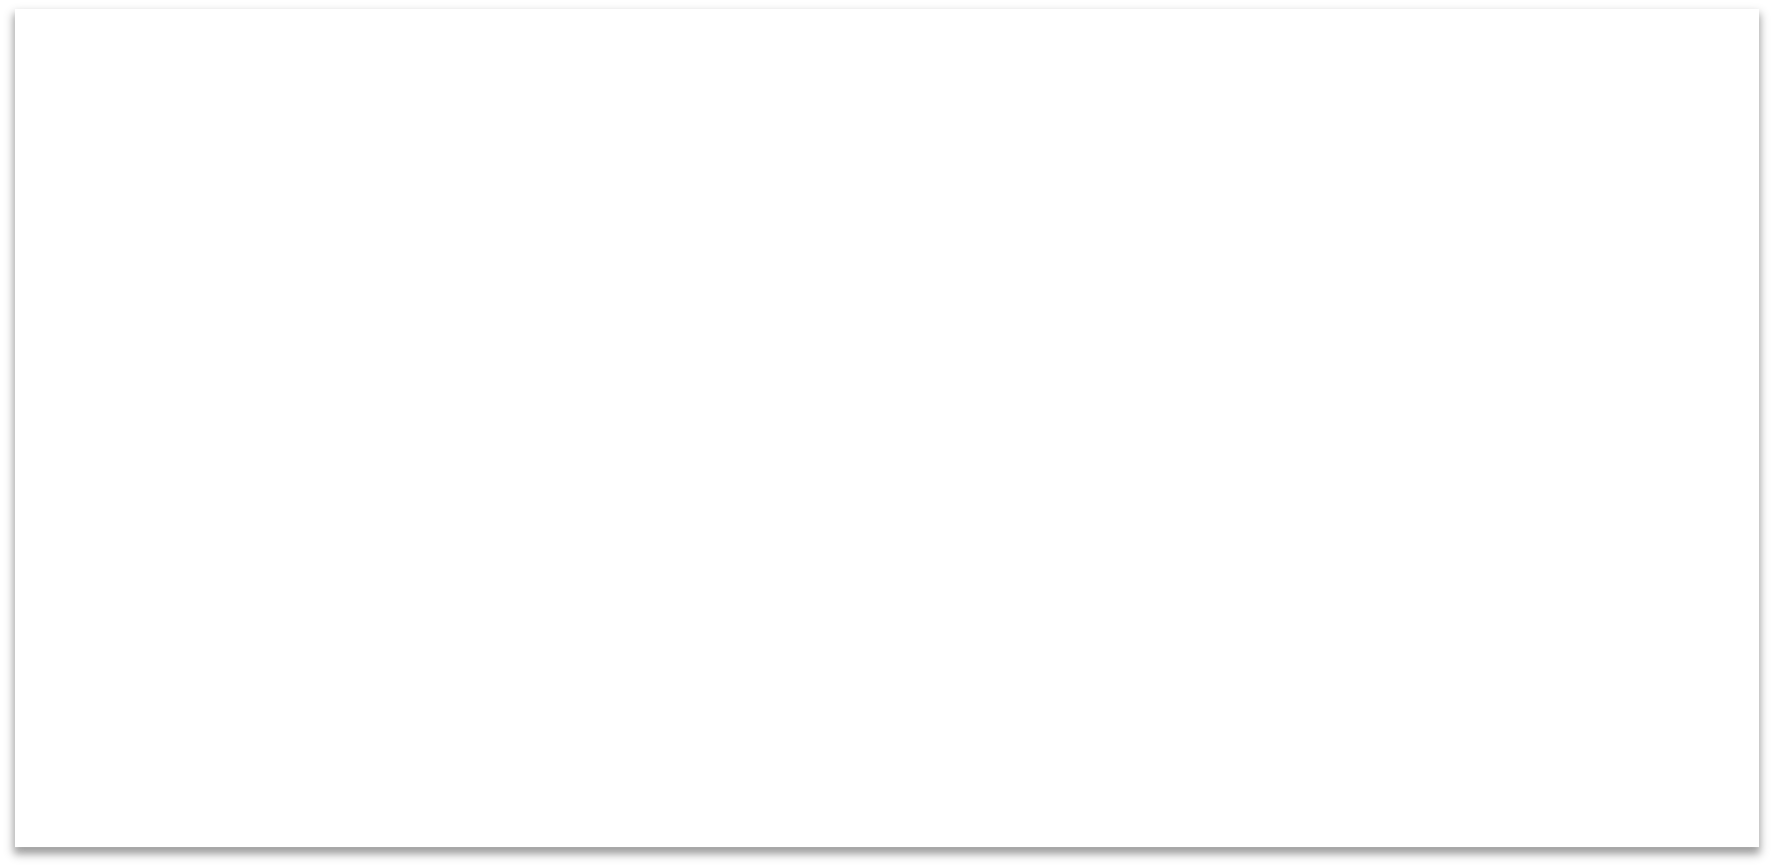

Manipulating Strings
There are many built-in functions for manipulating strings in Python.
The Example shows only a few of them:
a = "Hello World!" print(a) print(a[1])
print(a[2:5])
print(len(a))
print(a.lower())
print(a.upper()) print(a.replace("H", "J")) print(a.split(" "))
Strings in Python are arrays of bytes, and we can use index to get a specific character within the string as shown in the example code.

Slide 15



String Concatenation
We can merge strings like this:
a = "Hello"
b = "World"
c = a + b
print(c)
String Input
The following example asks for the user's name, then, by using the input() method,
the program prints the name to the screen:
x = input("Enter your name:")
print("Hello, " + x)

Slide 16
Built-in Functions
Python consists of lots of built-in functions.
Some examples are the print function that we already have used (perhaps without noticing it is a built-in function) or the functions for manipulating strings.
Python also consists of different Modules, Libraries or Packages. These Modules, Libraries or Packages consists of lots of predefined functions for different topics or areas, such as mathematics, plotting, handling database systems, etc.

Slide 17
Mathematics in Python
Python is a powerful tool for mathematical calculations
Python Standard Library
math Module
statistics Module
NumPy Library
You don't need to install the modules in the Python Standard Library separately, but you need to import them when you want to use some of these modules or some of the functions within these modules.

Slide 18
math Module
Python Standard Library
The math module has all the basic math functions you need, such as:
Trigonometric functions: sin(x), cos(x), etc.
Logarithmic functions: log(), log10(), etc.
Statistics: mean(), stdev(), etc.
Constants like pi, e, inf, nan, etc.

Slide 19






math Module
If we need only the sin() function, we can do like this:
from math import sin
x = 3.14
y = sin(x)
If we need many functions, we can do like this:
from math import *
x = pi
y = sin(x) print(y)
y = cos(x) print(y)
…
If we need a few functions, we can do like this:
from math import sin, cos
x = 3.14
y = sin(x)
We can also do like this:
print(y)
import math
x = 3.14
y = math.sin(x)
print(y)
y = cos(x) print(y)
You don't need to install the modules in the Python Standard Library separately, but you need to import them when you want to use some of these modules or some of the functions within these modules.

Slide 20
Python Packages/Libraries
Some important packages are:
NumPy - NumPy is the fundamental package for scientific computing with Python
SciPy - is an open-source library used for solving mathematical, scientific, engineering, and technical problems
Matplotlib – With this library you can easily make plots in Python
If you have installed Python using the Anaconda distribution, all the most used Python Packages/Libraries are included (NumPy, Matplotlib, +++)

Slide 21



Using libraries
You need to use the import keyword on top of you Python script:
import packagename as alias
.. Your Python code
import numpy as np
x = 3
y = np.sin(x)
print(y)
Example: Using numpy:

Slide 22
NumPy
In this example we use both the math module in the Python Standard Library and the NumPy library:
import math as mt import numpy as np
x = 3
y = mt.sin(x) print(y)
y = np.sin(x) print(y)
As you see, NumPy also have also similar functions (e.g., sim(), cos(), etc.) as those who is part of the math library, but they are more powerful
NumPy is included with Anaconda Distribution

Slide 23
Matplotlib in Python

Slide 24


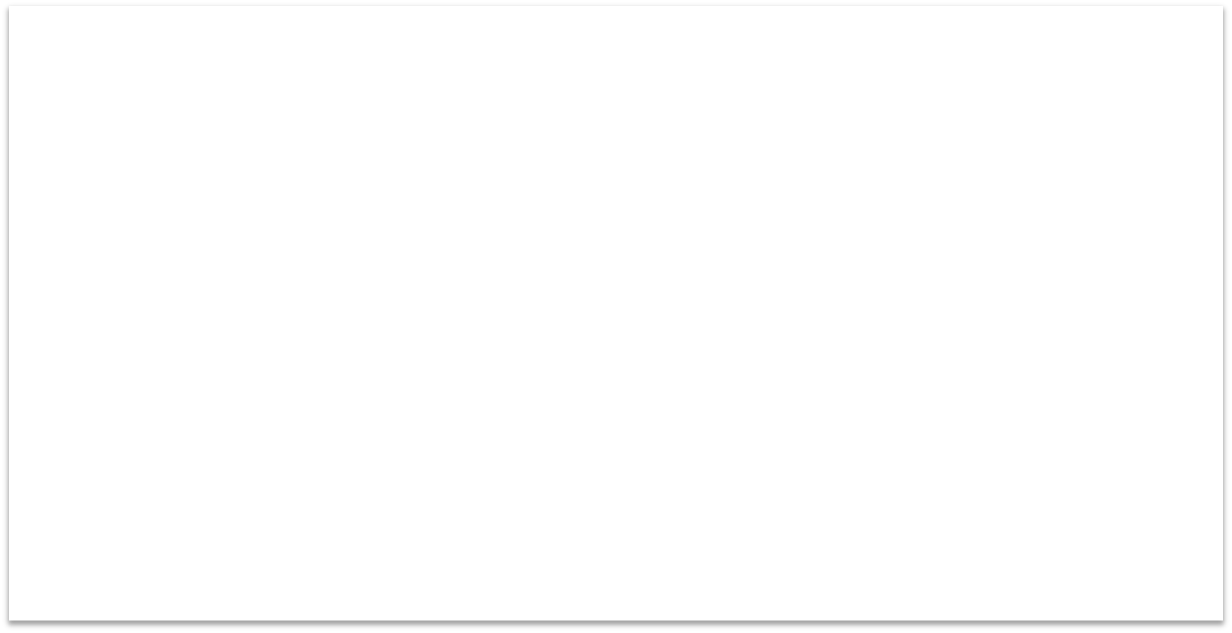

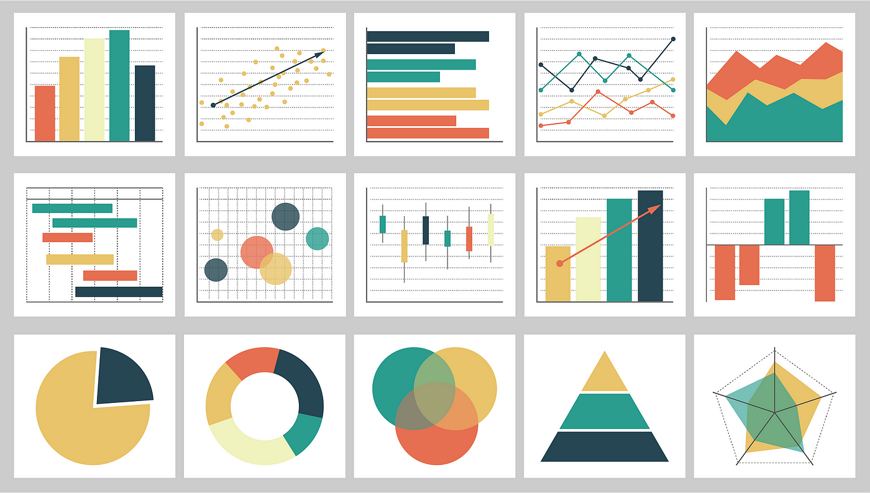
Matplotlib
import matplotlib.pyplot as plt
Typically you need to create some plots or charts. In order to make plots or charts in Python you will need an external library. The most used library is Matplotlib
Matplotlib is a Python 2D plotting library
Here you find an overview of the Matplotlib library: https://matplotlib.org
Matplotlib is included with Anaconda Distribution

Slide 25
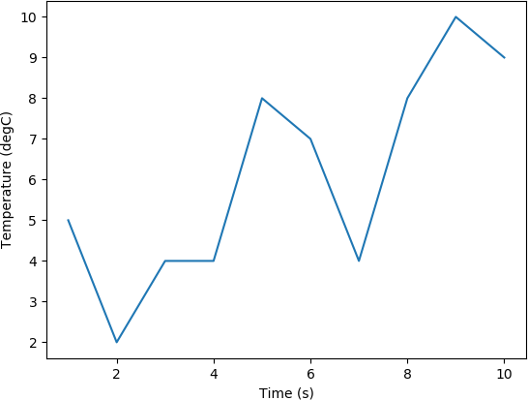
Matplotlib
In this example we have two arrays with data. We want to plot x vs. y. We can assume x is a time series and y is the corresponding temperature in degrees Celsius.
import matplotlib.pyplot as plt
x = [1, 2, 3, 4, 5, 6, 7, 8, 9, 10]
y = [5, 2,4, 4, 8, 7, 4, 8, 10, 9]
plt.plot(x,y)
plt.xlabel('Time (s)')
plt.ylabel('Temperature (degC)')
plt.show()

Slide 26
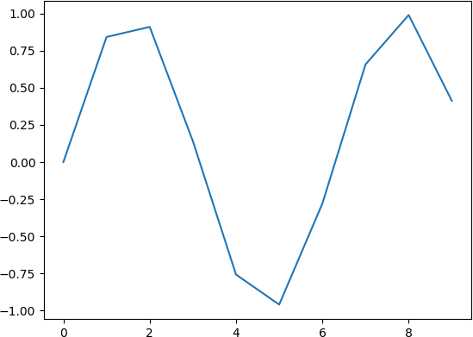
Matplotlib
Example: Plotting a Sine Curve
import numpy as np
import matplotlib.pyplot as plt
x = [0, 1, 2, 3, 4, 5, 6, 7]
y = np.sin(x) plt.plot(x, y)
plt.xlabel('x')
plt.ylabel('y') plt.show()
Note! The curve is not smooth due to few data points
If you want grids you can use the grid() function

Slide 27



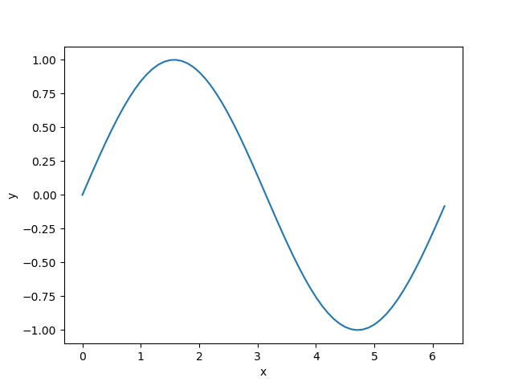
Matplotlib
Improved Solution: Plotting a Sine Curve
import matplotlib.pyplot as plt
import numpy as np
xstart = 0
xstop = 2*np.pi
increment = 0.1
x =np.arange(xstart,xstop,increment)
y = np.sin(x)
plt.plot(x, y)
plt.xlabel('x')
plt.ylabel('y')
plt.show()
Better!

Slide 28
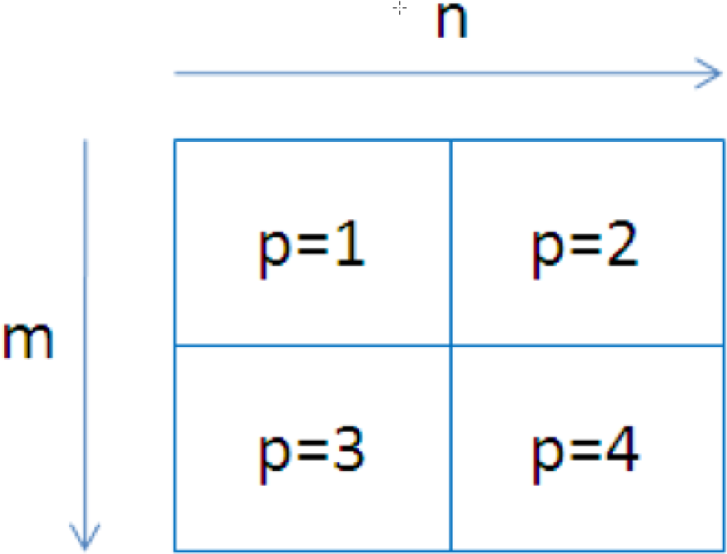



Sub-Plots
The subplot command enables you to display multiple plots in the same window (Figure)
Typing "subplot(m,n,p)" partitions the Figure window into an m-by-n matrix of small subplots.
subplot(2,2,1)

Slide 29

Sub-Plots
import matplotlib.pyplot as plt import numpy as np
xstart = 0 xstop = 2*np.pi increment = 0.1
x = np.arange(xstart,xstop,increment) y = np.sin(x)
plt.subplot(2,1,1) plt.plot(x, y) plt.title("Subplot Example") plt.xlabel('x')
plt.ylabel('sin(x)')
z = np.cos(x)
plt.subplot(2,1,2) plt.plot(x, z)
plt.xlabel('x')
plt.ylabel('cos(x)') plt.show()

Slide 30
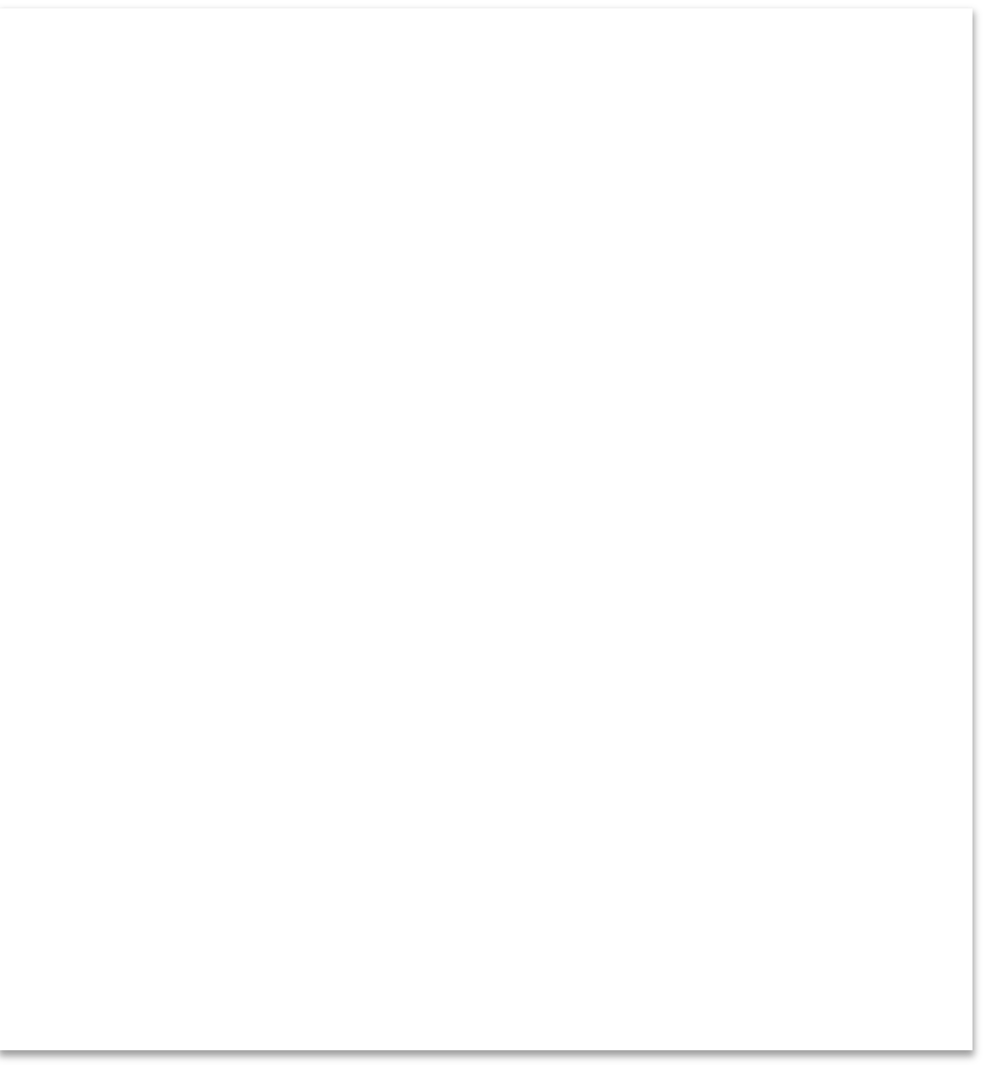


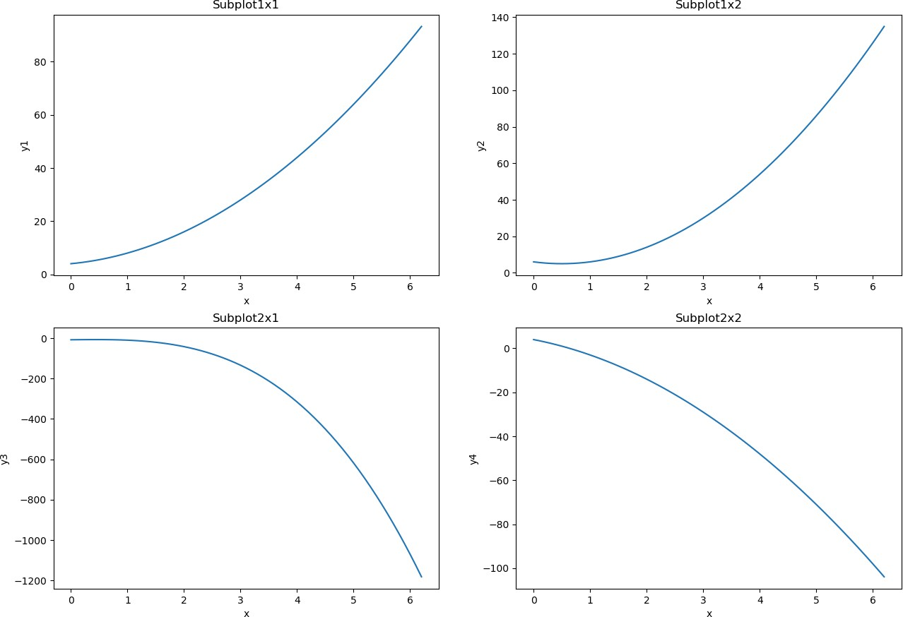



Sub-Plots
import matplotlib.pyplot as plt import numpy as np
xstart = 0 xstop = 2*np.pi increment = 0.1
x = np.arange(xstart,xstop,increment)
y1 = 2*x**2 + 2*x + 4 plt.subplot(2,2,1)
plt.plot(x, y1) plt.title("Subplot1x1") plt.xlabel('x')
plt.ylabel('y1’)
y2 = 4*x**2 - 4*x + 6 plt.subplot(2,2,2) plt.plot(x, y2) plt.title("Subplot1x2") plt.xlabel('x')
plt.ylabel('y2')
y3 = -5*x**3 + 3*x - 8 plt.subplot(2,2,3)
plt.plot(x, y3)
plt.title("Subplot2x1")
plt.xlabel('x')
plt.ylabel('y3')
y4 = -2*x**2 - 5*x + 4 plt.subplot(2,2,4)
plt.plot(x, y4)
plt.title("Subplot2x2")
plt.xlabel('x')
plt.ylabel('y4') plt.show()

Slide 31
Loops and Conditions in Python

Slide 32



Conditions
We have the following Conditions we can use in Python:
a == b # Equals
a != b # Not
a <
a <= b a > b # a
Equals
b # Less than
# Less than or equal to
Greater
than
than or equal to
>= b # Greater

Slide 33

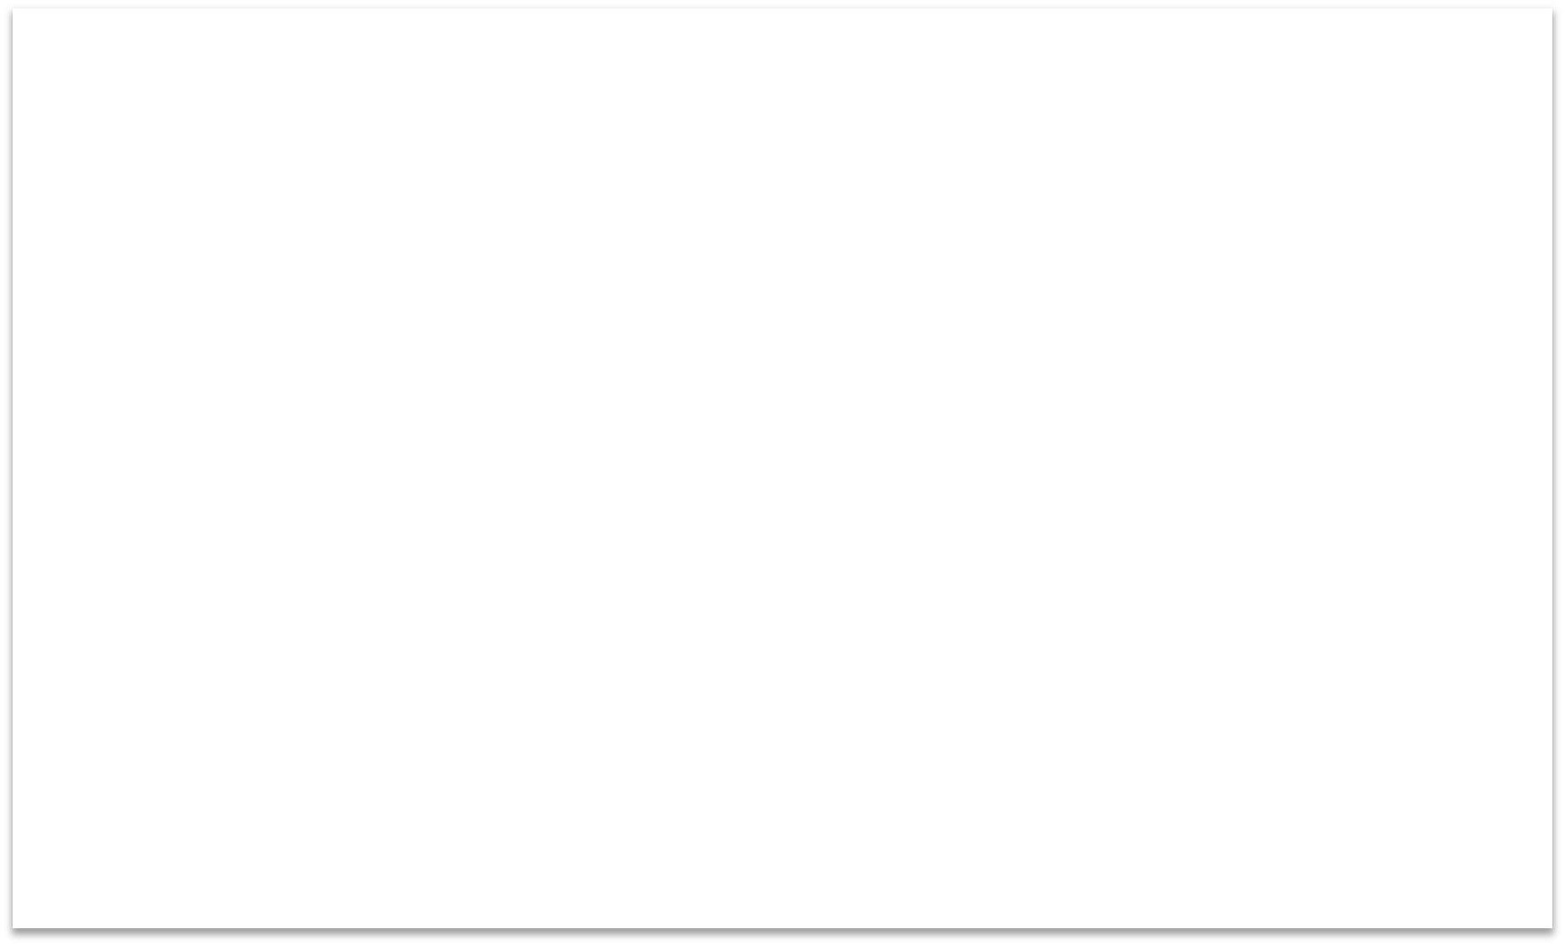

If
a = 5
b = 8
Note also the colon (:)
if a > b:
print("a is greater than b")
Note! Python uses indentation (spaces)
if b > a:
print("b is greater than a")
Other Programming Languages uses curly brackets {} or Begin .. End
if a == b:
print("a is equal to b")
Try to change the values for the variables a and b

Slide 34



If - Else
If you have 2 conditions that you need to check, you can use If – Else:
a = 5
b = 8
if a > b:
print("a is greater than b")
else:
print("b is greater than a or a and b are equal")

Slide 35

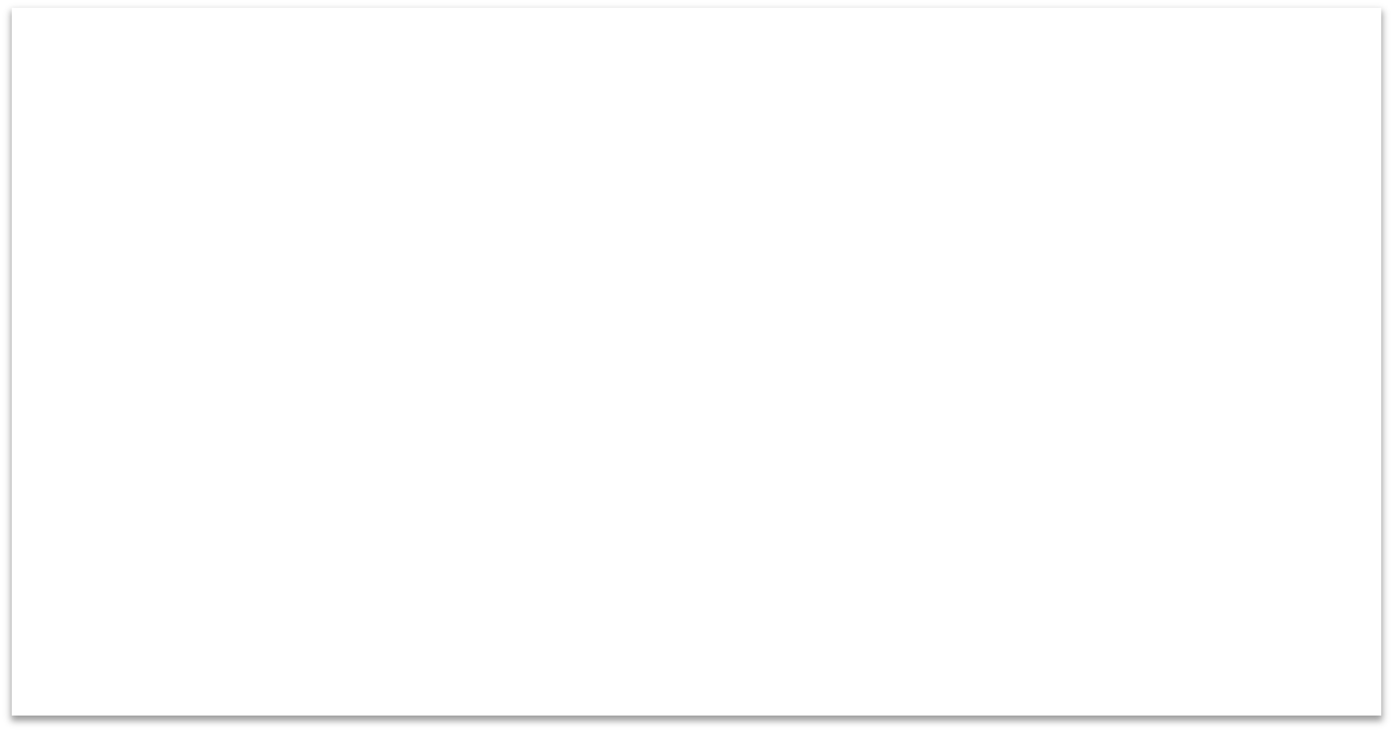

Elif
If you have more than 2 different conditions you need to check, you typically use Elif:
a = 5
b = 8
if a > b:
print("a
elif b > a:
print("b
elif a == b:
print("a
Note! Python uses "elif" not "elseif" like many other programming languages do
is greater than b")
is greater than a")
is equal to b")
If need, you can also add an Else at the end for handling “all other conditions”

Slide 36












Lists
An array is a special variable, which can hold more than one value at a time Example:
data = [1.6, 3.4, 5.5, 9.4]
Python does not have built-in support for Arrays, but Python Lists can be used instead.
Length of an Array (List): Get a specific element (Indexing):
N = len(data)
x = data[2]
Change a specific element:
Add a new value to the end of the Array (List):
data[2] = 7.3
data.append(11.4)
For more advanced use of Arrays in Python you have to import a library, like the NumPy library.

Slide 37


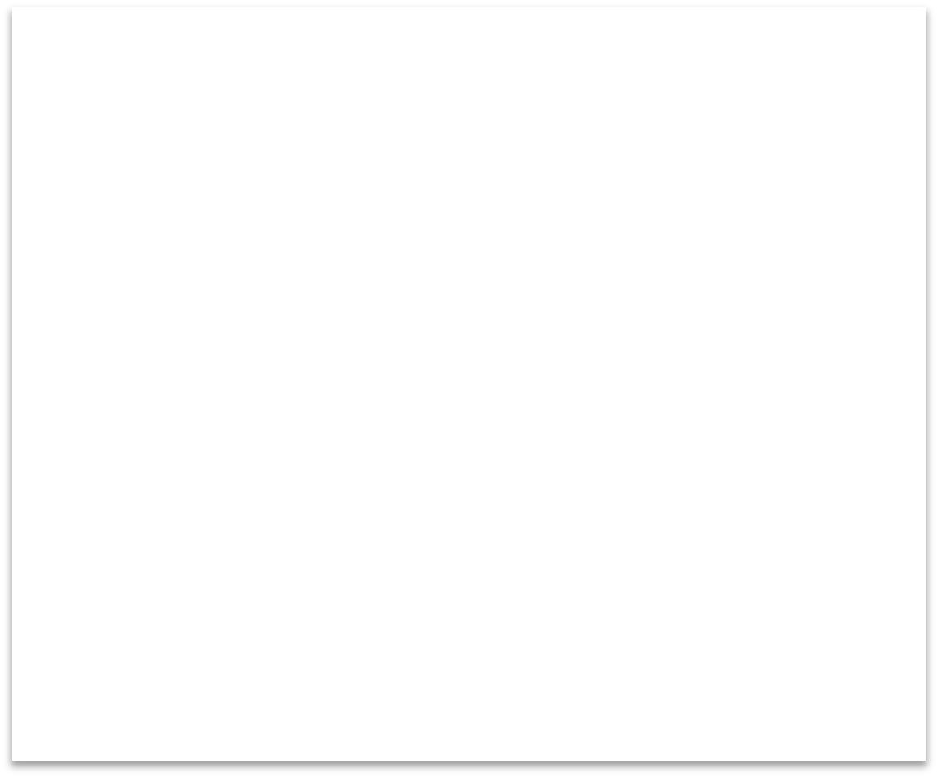

Arrays of Strings
You can also create an Array (List) of Strings:
cars = ["Ford", ”Toyota", ”Tesla"]
Some useful Functions for manipulating the Array (List):
x = cars[1]
x = len(cars)
cars.append(”Porche") cars.remove(”Tesla") cars.sort()

Slide 38






For Loops
A For loop is used for iterating over a sequence.
Example:
cars = ["Ford", "Toyota", "Tesla"]
for car in cars:
print(car)
Array (List) of Strings
Note! Python uses indentation (spaces)
Other Programming Languages uses curly brackets {} or Begin .. End
Example:
data = [1.6, 3.4, 5.5, 9.4]
for x in data:
print (x)
Array (List) of Numbers

Slide 39
For Loops
The range() function is handy to use in For Loops:
N = 10
for x in range(N): print(x)
You can also use the range() function like this:
start = 4
stop= 12 #but not including
for x in range(start, stop):
print(x)
The range() function returns a sequence of numbers, starting from 0 by default, and increments by 1 (by default), and ends at a specified number.
start = 4
stop = 12 #but not including step = 2
for x in range(start, stop, step): print(x)
Or like this:

Slide 40
For Loops - Example
Example: Find the Sum and Average/Mean for some given Data:
data = [1, 5, 6, 3, 12, 3]
sum = 0
for x in data:
sum = sum += x print(sum)
N = len(data)
mean = sum/N
print(mean)

Slide 41
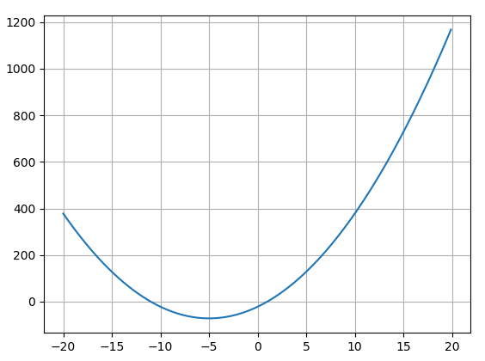
While Loops
Example: We want to find for what value of x the function has its minimum value
𝑦 𝑥 = 2𝑥² + 20𝑥 − 22
We can of course find the derivative of the function and find where the derivative is equal to zero:
𝑑𝑥
This gives:
^{𝑑𝑦} = 4𝑥 + 20 = 0
(−5, −72)
𝑥 = −5
𝑦 −5
= 50 − 100 − 22 = −72
The minimum of the function

Slide 42



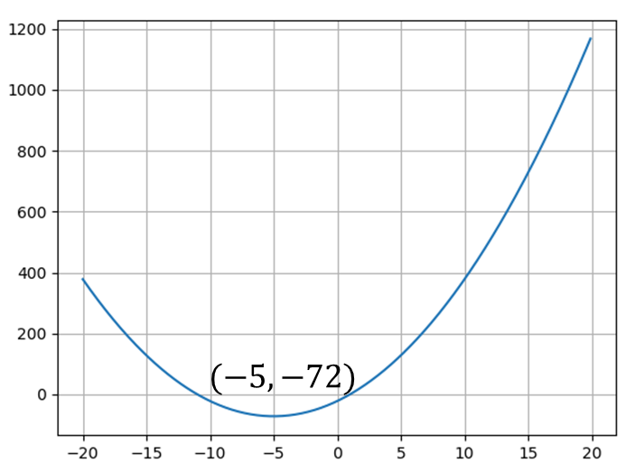
While Loops
Example: We want to find for what value of x the function has its minimum value
𝑦(𝑥) = 2𝑥² + 20𝑥 − 22
We use Python to iterate through all values of 𝑦(𝑥) using a While Loop.
Inside the While Loop we compare 𝑦(𝑖)
and 𝑦(𝑖 + 1). If 𝑦 (𝑖 + 1)is larger than
𝑦(𝑖) we have found the minimum.
The Python results becomes the same as the analytical solution:
(−5, −72)
import numpy as np
import matplotlib.pyplot as plt
xstart = -20
xstop = 20
increment = 0.1
x = np.arange(xstart,xstop,increment) y = 2 * x*x + 20 * x - 22
plt.plot(x,y) plt.grid()
i = 0
while y[i] > y[i+1]: i = i+1
print(x[i])
print(y[i])

Slide 43
Create Functions
So far, we have used many of the built-in functions in Python, like print(), plot(), len(), etc.
There are many built-in functions in Python
We can also use functions which are part of many of the additional Python Libraries like NumPy, Matplotlib, etc.
Still, very often we need to make our own functions from scratch

Slide 44

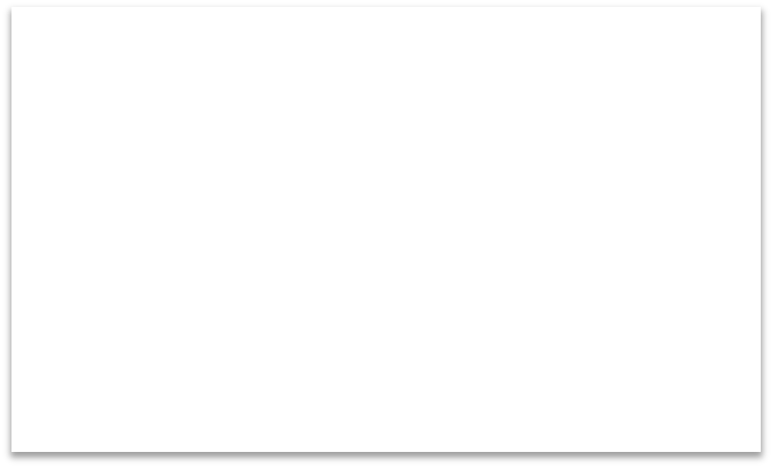

Function Definition
Note that you need to use a colon ":" at the end of line where you define the function.
def FunctionName:
<statement-1>
.
.
<statement-N>
return ...
Note! Python uses indentation (spaces)
Other Programming Languages uses curly brackets {} or Begin .. End
The return value should be stated here

Slide 45



Create Functions
Create the Function:
def add(x,y):
z = x + y return z
# Using the Function: x = 2
y = 5
Using the Function within the same script:
z = add(x,y)
print(z)

Slide 46

Create Functions in a Separate File
Although you can mix functions and code in one file, it is much better to create the functions in separate .py files
In that way you can easily reuse the function in different Python scripts
2 Next, we create a new Python File (e.g., testaverage.py) where we use the function we created:
1
We start by creating a separate
Python File, e.g., “myfunctions.py“ for the function:
from myfunctions import average
a = 2
b = 3
c = average(a,b)
print(c)
myfunctions.py:
def average(x,y):
return (x + y)/2

Slide 47



Multiple Return Values
def stat(x):
totalsum = 0
Function with multiple return values
#Find the Sum of all the numbers for x in data:
totalsum = totalsum + x
Create Function
#Find the Mean or Average N = len(data)
mean = totalsum/N
return totalsum, mean
of all the numbers
# Using the function
data = [1, 5, 6, 3, 12, 3]
In general, it is recommended to create the function(s) in separate File(s) as shown in the previous example
Use Function
totalsum, mean = stat(data)
print(totalsum, mean)

Slide 48
Mathematics in Python

Slide 49



Mathematical Expressions
Let's create the following mathematical expression in Python:
𝑓(𝑥, 𝑦) = 3𝑥² +
_{𝑥}2 _{+ 𝑦}2 _{+ 𝑒}𝑙𝑛(𝑥)
𝑓 2,2 =?
Python Code:
import math as mt
x = 2
y = 2
f = 3*mt.pow(x,2) + mt.sqrt(mt.pow(x,2) + mt.pow(y,2)) + mt.exp(mt.log(x))
print(f)
The answer becomes 𝑓(2,2) = 16.83

Slide 50



Mathematical Expressions
Let's create a function that calculates the following mathematical expression:
𝑓(𝑥, 𝑦) = 3𝑥² +
_{𝑥}2 _{+ 𝑦}2 _{+ 𝑒}𝑙𝑛(𝑥)
Python Code:
import math as mt
def func_ex(x,y):
f = 3*mt.pow(x,2) return f
+ mt.sqrt(mt.pow(x,2) + mt.pow(y,2)) + mt.exp(mt.log(x))
x = 2
y = 2
f = func_ex(x,y) print(f)

Slide 51
NumPy
The Python Standard Library consists basic Math functions, for fore advanced Math functions, you typically want to use the NumPy Library
If you don’t have Python yet and want the simplest way to get started, you can use the Anaconda Distribution - it includes Python, NumPy, and other commonly used packages for scientific computing and data science.
https://numpy.org

Slide 52
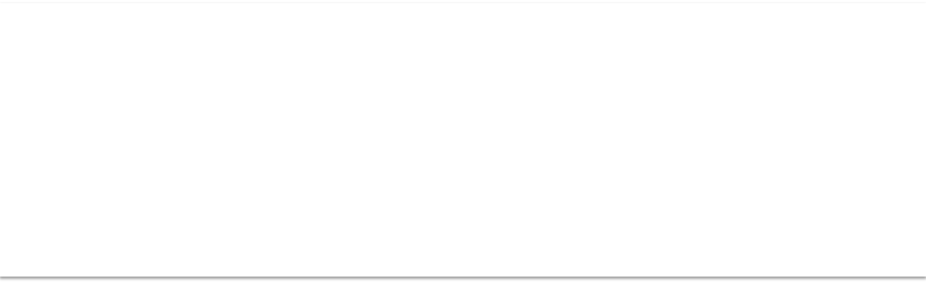

Mathematical Expressions
Let's create the following mathematical expression in Python using NumPy:
𝑓(𝑥, 𝑦) = 3𝑥² +
_{𝑥}2 _{+ 𝑦}2 _{+ 𝑒}𝑙𝑛(𝑥)
𝑓 2,2 =?
Python Code:
Previously we used math in the Python Standard Library
import numpy as np
def func_ex(x,y):
f = 3*np.power(x,2) return f
+ np.sqrt(np.power(x,2) + np.power(y,2)) + np.exp(np.log(x))
x = 2
y = 2
f = func_ex(x,y) print(f)
The answer becomes 𝑓(2,2) = 16.83

Slide 53



Mathematical Expressions
𝑓(𝑥, 𝑦) = 3𝑥² +
_{𝑥}2 _{+ 𝑦}2 _{+ 𝑒}𝑙𝑛(𝑥)
import numpy as np
def func_ex(x,y):
f = 3*np.power(x,2) + np.sqrt(np.power(x,2) + np.power(y,2)) + np.exp(np.log(x))
return f
start = 0
stop = 11
increment = 1
x_data = np.arange(start,stop,increment)
y_data = np.arange(start,stop,increment)
for x in x_data:
for y in y_data:
f = func_ex(x,y)
print(f"f({x},{y})={f}")
Let's find the values of 𝑓(𝑥, 𝑦) for
0 ≤ 𝑥 ≤ 10 and 0 ≤ 𝑦 ≤ 10
In order to do that we can use a
Nested For loop:

Slide 54



Statistics
Example:
Statistics using the statistics module in
Python Standard Library:
import statistics as st
data = [-1.0, 11, 2.5, 3.25, 5.75]
#Mean or Average m = st.mean(data) print(m)
# Standard Deviation st_dev = st.stdev(data) print(st_dev)
# Median
med = st.median(data) print(med)
# Variance
var = st.variance(data) print(var)

Slide 55
Statistics
Note! statistics is a sub library in the Python Standard Library
Example:
from statistics import *
data = [1.6, 3.4, 5.5, 9.4]
m = mean(data) sd = stdev(data)
datamin = min(data) datamax = max(data)

Slide 56
Trigonometric Functions
Python offers lots of Trigonometric functions, e.g., sin, cos, tan, etc.
Note! Most of the trigonometric functions require that the angle is expressed in radians.
We can use Math module in the Python Standard Library
Or we can use the NumPy library

Slide 57



Trigonometric Functions
Trigonometric functions in the Math module in the Python Standard Library:
import math as mt
x = 2*mt.pi y = mt.sin(x)
print(y)
y = mt.cos(x)
print(y)
y = mt.tan(x)
print(y)

Slide 58



Trigonometric Functions
Plotting Example using a For Loop and the matplotlib library:
import math as mt
import matplotlib.pyplot as plt
xdata = [] ydata = []
for x in range(0, 10):
xdata.append(x) y = mt.sin(x)
ydata.append(y)
plt.plot(xdata, ydata)
plt.show()

Slide 59



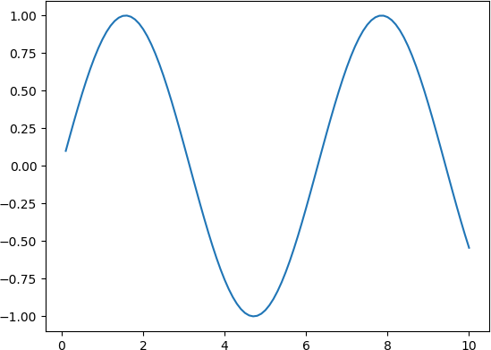



Trigonometric Functions
Improved Plotting Example:
“Smoother“ curve:
import math as mt
import matplotlib.pyplot as plt
x = 0
N = 100
xdata = []
ydata = []
for i in range(0, N):
x = x + 0.1
xdata.append(x)
y = mt.sin(x)
ydata.append(y)
plt.plot(xdata, ydata)
plt.show()
The problem with using the Trigonometric functions in the the Math module from the Python Standard Library is that they don't handle an array as input.

Slide 60



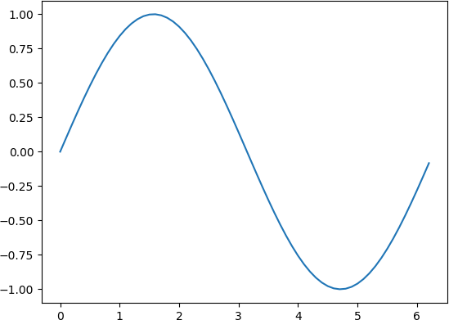
Trigonometric Functions
Using NumPy:
The Trigonometric Functions in the NumPy library can handle arrays as input arguments. No For Loop needed!
import numpy as np
import matplotlib.pyplot as plt
xstart = 0
xstop = 2*np.pi
increment = 0.1
x = np.arange(xstart,xstop,increment)
y = np.sin(x)
plt.plot(x, y)
plt.show()

Slide 61
Polynomials
A polynomial is expressed as:
𝑝(𝑥) = 𝑝₁𝑥^{𝑛} + 𝑝₂𝑥^{𝑛$1} + ⋯ + 𝑝_{𝑛}𝑥 + 𝑝_{𝑛+1}
where 𝑝₁, 𝑝₂, 𝑝₃, … are the coefficients of the polynomial. We will use the Polynomial Module in the NumPy Package.
https://numpy.org/doc/stable/reference/routines.polynomials.polynomial.html

Slide 62
Polynomials
Given the following polynomial:
𝑝 𝑥 = −5.45𝑥⁺ + 3.2𝑥² + 8𝑥 + 5.6
We need to rewrite it like this in Python:
𝑝 𝑥 = 5.6 + 8𝑥 + 3.2𝑥² + 0𝑥³ −5.45𝑥⁴
import numpy.polynomial.polynomial as poly
p = [5.6, 8, 3.2, 0, -5.45]
r = poly.polyroots(p)
print(r)
𝑝 𝑥
= 0 → 𝑥 =?

Slide 63



Polynomials
Given the following polynomial:
𝑝 𝑥 = −2.1𝑥⁺ + 2𝑥³ + 5𝑥 + 11
We need to rewrite it like this in Python:
𝑝 𝑥 = 11 + 5𝑥 + 0𝑥² + 2𝑥³ − 2.1𝑥⁴
import numpy.polynomial.polynomial as poly
p = [11, 5, 0, 2, -2.1]
r = poly.polyroots(p)
print(r)
x = 2
px = poly.polyval(x, p)
print(px)
𝑝 𝑥 = 0 → 𝑥 =?
𝑝 2 =?

Slide 64



Polynomials
import numpy.polynomial.polynomial as poly
p1 = [1, 1, -1]
p2 = [2, 0, 0, 1]
p = poly.polymul(p1, p2)
print(p)
Given the following polynomials:
𝑝₁ 𝑥 = 1 + 𝑥 − 𝑥²
𝑝₂ 𝑥 = 2 + 𝑥³
Let's find the polynomial 𝑝(𝑥) =𝑝₁(𝑥) 𝑝₂(𝑥) using Python

Slide 65



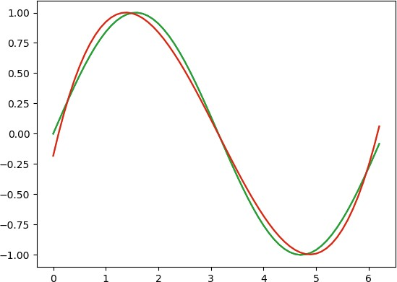
Polynomial Fitting
Find a Polynomial that best fits the following function:
𝑦 = sin(𝑥)
Try with different order of the polynom
N = 3
import numpy as np
import numpy.polynomial.polynomial as poly
import matplotlib.pyplot as plt
xstart = 0 xstop = 2*np.pi increment = 0.1
x = np.arange(xstart,xstop,increment) y = np.sin(x)
plt.plot(x, y)
N = 3 #order of polynomial
p = poly.polyfit(x,y,N) print(p)
y2 = poly.polyval(x, p)
plt.plot(x, y2) plt.show()

Slide 66
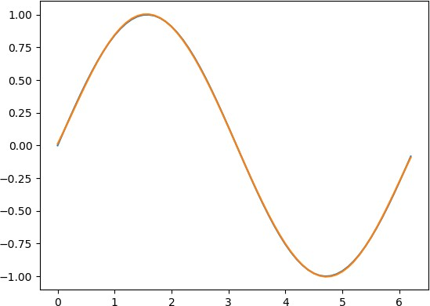

Polynomial Fitting
Find a Polynomial that best fits the following function:
𝑦 = sin(𝑥)
N = 3
N = 5
[ 0.01223516 0.87014661 0.27985151 -0.39981223 0.08841641 -0.0056342 ]
𝑝 𝑥 = 0.01 + 0.87𝑥 + 0.28𝑥² − 0.4𝑥³ + 0.09𝑥⁴ − 0.006𝑥⁵
[-0.18215486 1.88791463 -0.87536931 0.09309684]
𝑝 𝑥 = −0.18 + 1.88𝑥 − 0.88𝑥² + 0.09𝑥³

Slide 67
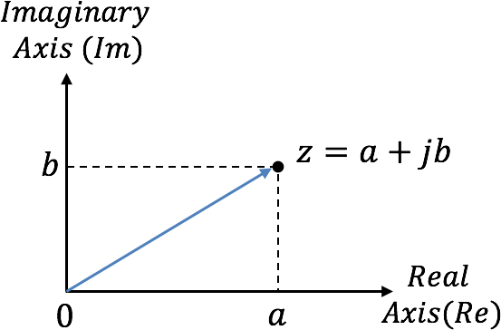



Complex Numbers
A complex number is defined like this:
𝑧 = 𝑎 + 𝑗𝑏
Where 𝑎 is called the real part of 𝑧 and 𝑏 is called the imaginary part of 𝑧,
𝑅𝑒(𝑧) = 𝑎, 𝐼𝑚(𝑧) = 𝑏
The imaginary 𝑗 is defined as:
𝑗 = −1
In Python you define a complex number like this:
z = 3 + 2j

Slide 68
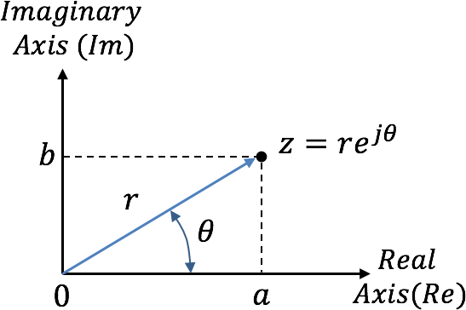
Complex Numbers – Polar Form
Complex numbers can also be expressed on exponential/polar form:
𝑧 = 𝑟𝑒^{jθ}
𝑎²+𝑏²
𝑏
𝑎
Where: 𝑟 = 𝑧 =
𝜃 = 𝑎𝑡𝑎𝑛
Note that 𝑎 = 𝑟 cos 𝜃 and 𝑏 = 𝑟 sin 𝜃

Slide 69



Complex Numbers
Given the following complex numbers:
𝑎 = 5 + 3𝑗
𝑏 = 1 − 1𝑗
a = 5 + 3j b = 1 - 1j
c = a + b print(c)
d = a - b print(d)
e = a * b print(e)
f = a / b print(f)
In Python we can define the complex numbers and perform basic operations (+, -, *, /) like this:

Slide 70



Complex Numbers
import cmath
x = 2
y = -3
In addition, there exists several Complex Number Functions in Python. We use the cmath library:
cmath.phase(x) cmath.polar(x) cmath.rect(r, phi) cmath.exp(x) cmath.log10(x) cmath.sqrt(x) cmath.acos(x) cmath.asin(x) cmath.atan(x) cmath.cos(x) cmath.sin(x) cmath.tan(x)
https://docs.python.org/3/library/cmath.html
#
z
converting x and y into complex number
= complex(x,y)
print(z.real) print(z.imag)
print(z.conjugate())
# converting to polar form w = cmath.polar(z)
print (w)
# converting to to rectangular form w = cmath.rect(2,3)
print (w)

Slide 71
File Handling in Python

Slide 72
File Handling in Python
Python has several functions for creating, reading, updating, and deleting files
The key function for working with files in Python is the open()function.
The open()function takes two parameters; Filename, and Mode.

Slide 73
File Handling in Python
There are four different methods (modes) for opening a file:
"x" - Create - Creates the specified file, returns an error if the file exists
"w" - Write - Opens a file for writing, creates the file if it does not exist
"r" - Read - Default value. Opens a file for reading, error if the file does not exist
"a" - Append - Opens a file for appending, creates the file if it does not exist
In addition you can specify if the file should be handled as binary or text mode
"t" - Text - Default value. Text mode
"b" - Binary - Binary mode (e.g. images)

Slide 74
Write Data to File
File Name x = Create
f = open("myfile.txt", "x")
data = "Hello World"
f.write(data) f.close()

Slide 75
Read Data from File
File Name
r = Read
f = open("myfile.txt", "r")
data = f.read()
print(data) f.close()
To read to an existing file, you must add the following parameter to the open() function:
"r" - Read - Default value. Opens a file for reading, error if the file does not exist

Slide 76

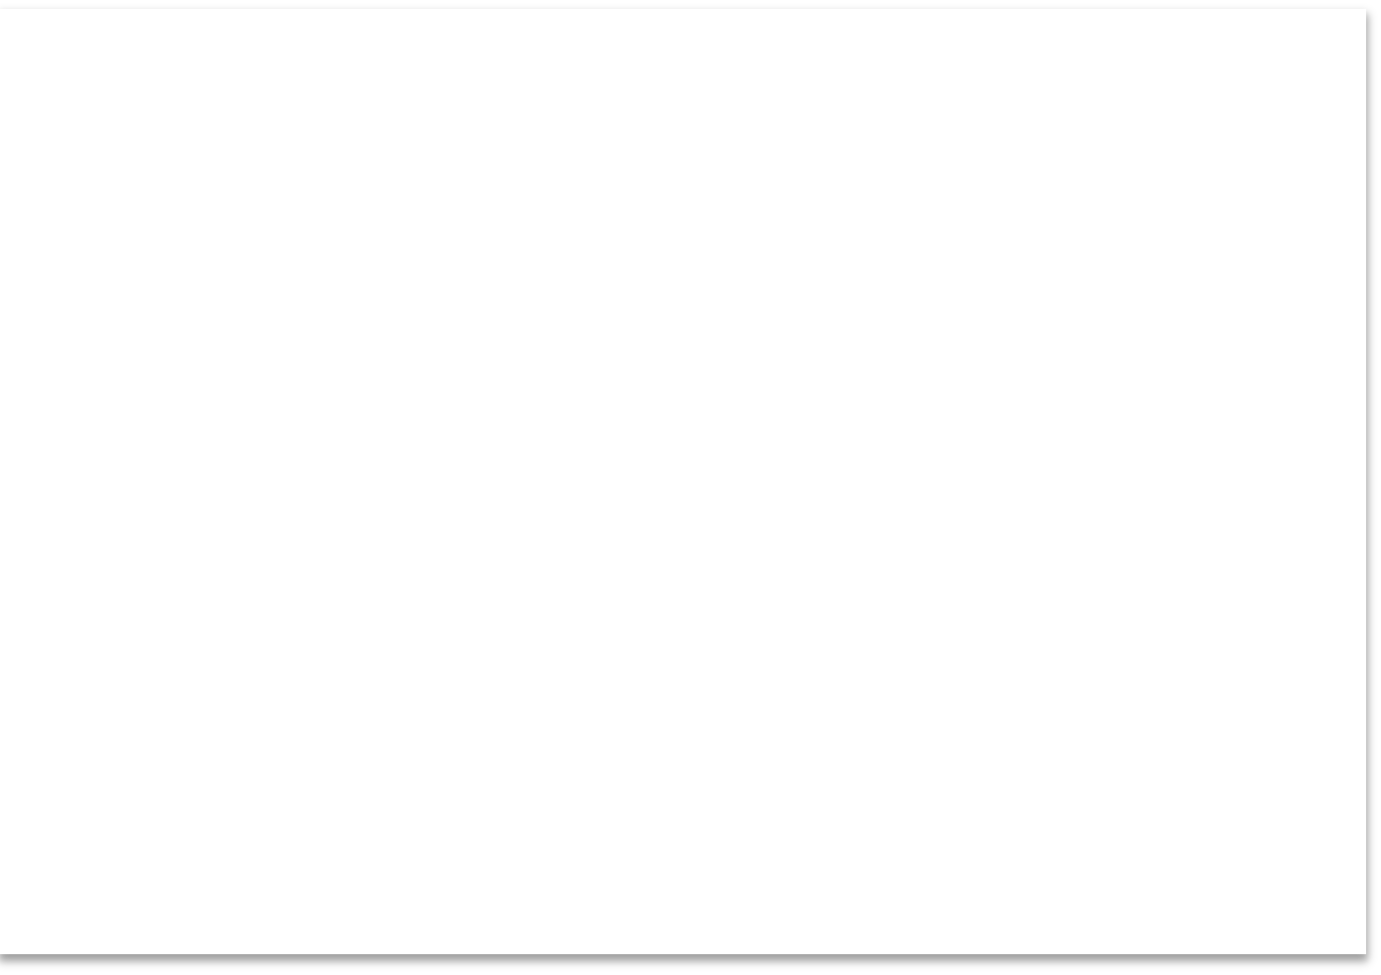

Logging Data to File
Typically you want to write multiple data to the, e.g., assume you read some temperature data at regular intervals and then you want to save the temperature values to a File.
Logging Data to File:
Read Logged Data from File:
data = [1.6, 3.4, 5.5, 9.4]
f = open(”logdata.txt", "x")
f = open("logdata.txt", "r")
for record in f:
record = record.replace("\n", "") print(record)
f.close()
for value in data: record = str(value) f.write(record) f.write("\n")
Add New Line (or “Enter“)
f.close()

Slide 77




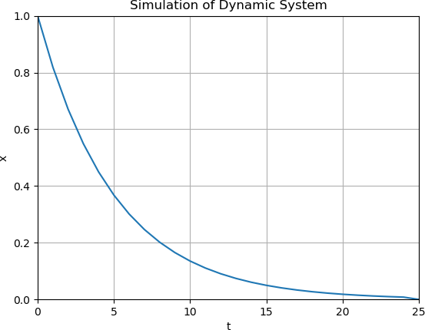
Simulation and Plotting
Given the system (differential equation): 𝑥̇ = 𝑎𝑥
The solution is given by: 𝑥 𝑡 = 𝑒^{𝑎𝑡}𝑥₀
import math as mt
import numpy as np
import matplotlib.pyplot as plt
# Model Parameters
T = 5
a = -1/T
# Simulation Parameters
x0 = 1
t = 0
tstart = 0
tstop = 25
increment = 1
x = []
x = np.zeros(tstop+1)
t = np.arange(tstart,tstop+1,increment)
# Define the Function
for k in range(tstop):
x[k] = mt.exp(a*t[k]) * x0
# Plot the Simulation Results
plt.plot(t,x)
plt.title('Simulation of Dynamic System')
plt.xlabel('t')
plt.ylabel('x')
plt.grid()
plt.axis([0, 25, 0, 1])
plt.show()
Where I T is the time constant, 𝑇 = 5
Initial condition: 𝑥 0 = 𝑥_{𝑜} = 1 0 ≤ 𝑡 ≤ 25
We should add Grid, and proper Title and Axis Labels to the plot

Slide 78

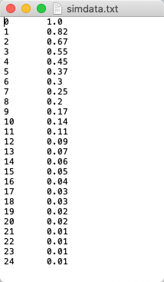
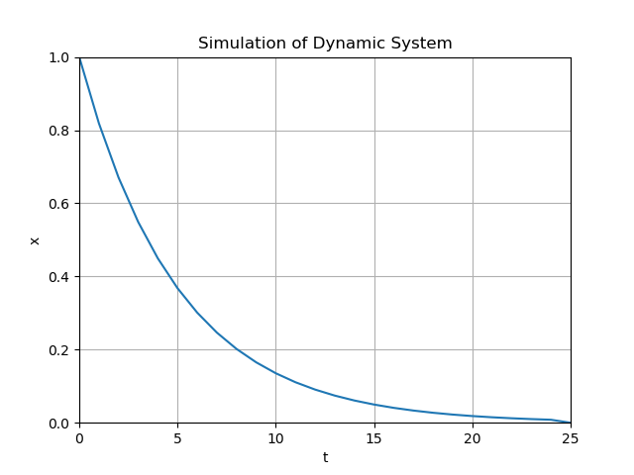
Logging Simulation Data
import math as mt import numpy as np
import matplotlib.pyplot as plt
# Open File
f = open("simdata.txt", "w")
def writedata(t, x): time = str(t)
value = str(round(x, 2)) f.write(time + "\t" + value) f.write("\n")
# Model Parameters T = 5
a = -1/T
# Simulation Parameters x0 = 1
t = 0
tstart = 0
tstop = 25
increment = 1
x = []
x = np.zeros(tstop+1)
t = np.arange(tstart,tstop+1,increment)
for k in range(tstop):
x[k] = mt.exp(a*t[k]) * x0
writedata(t[k], x[k])
f.close()
# Plot the Simulation Results plt.plot(t,x)
plt.title('Simulation of Dynamic System')
plt.xlabel('t')
plt.ylabel('x')
plt.grid()
plt.axis([0, 25, 0, 1]) plt.show()

Slide 79



Code Details
Convert to String values Show values with 2 Decimals
def writedata(t, x): time = str(t)
value = str(round(x, 2))
f.write(time + "\t" + value) f.write("\n")
Add Tabulator, so the t and x will be in 2 separate columns in the file
Add New Line (or “Enter“)

Slide 80
Read Simulation Data
import matplotlib.pyplot as plt
f = open("simdata.txt", "r")
t = []
x = []
for record in f:
record = record.replace("\n", "")
time, value = record.split("\t")
t.append(int(time)) x.append(float(value))
f.close()
# Plot the File Data plt.plot(t,x) plt.title('Simulation of Dynamic System')
plt.xlabel('t')
plt.ylabel('x')
plt.grid() plt.show()

